Slide 1
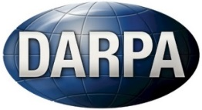
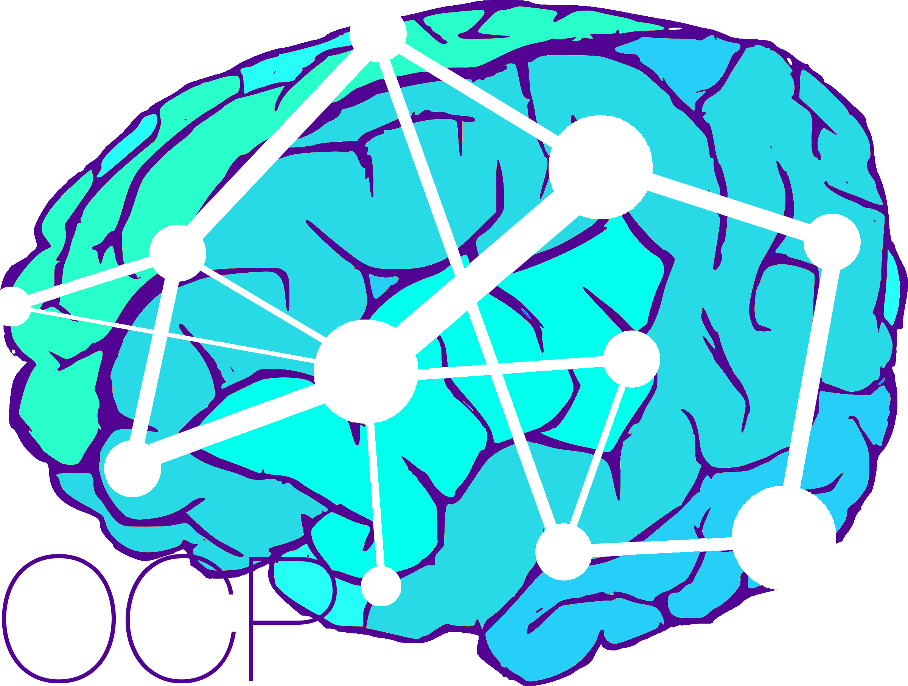
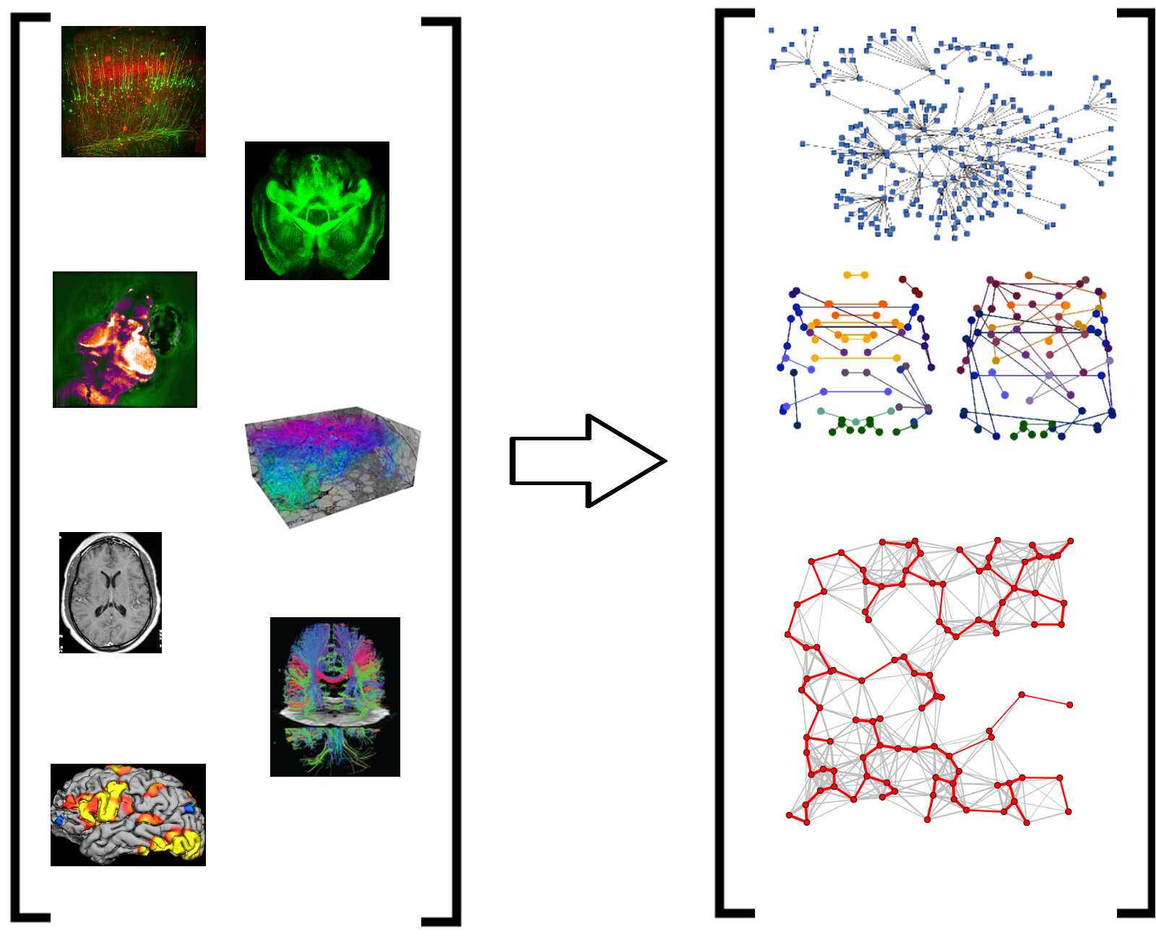
From RAGs to Riches: Utilizing Richly Attributed Graphs to Reason from Heterogeneous Data
Neuroscience Use Case Impact
Build and apply infrastructure to accurately & reliably estimate richly attributed tera-edge graphs, from tera-byte image volumes. Applications include human MR data and mouse CLARITY data.
Target: Enable anyone, regardless of computational resources and knowledge, to access and analyze state-of-the-art datasets using state-of-the-art methods.
Currently, custom cluster computers are required.
Currently, the most expensive and exciting datasets are silo’ed in the experimental labs that collected them, and the algorithms required to analyze them use custom cluster computers.
Cross-Domain SIMPLEX Impact
Tera-voxel image processing and tera-edge richly attributed graphs arise in a wide variety of application domains.
All our code is open source, and we make readily available virtual machines for cloud deployment.
Notes:
Add verb phrase to connect to MGI (supporting, extending, surpassing, …)
Add a metric for high-performance

